Slide 1
DOCSTORE
Prepare By:
Darshil S. Patel
Guided By:
Prof. Harsh Patel

Slide 2
Introduction
In the name of this project DocStore we can analyzes that Doc means document and Store means stoager that will sacn the objects and store into the secondary storage of any smartphone devices.
This project is basically using react native framework which scan and store the objects.

Slide 3
Table Of Contains:
Technology
Technology that will use in this project.
Why I Select This Project?
Use Of DOCSTORE.
Why?
Project Objective
Functional Specifications
Future Scope

Slide 4
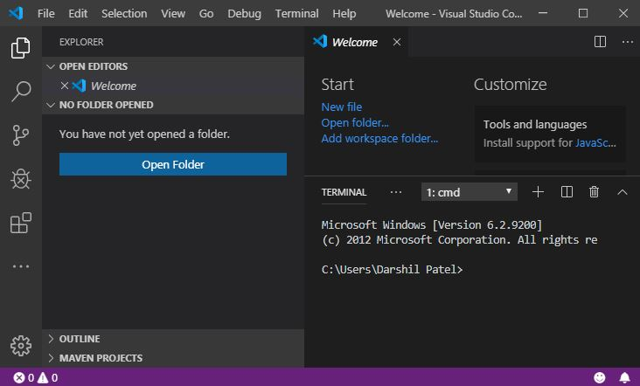

Technology
Technology that will use in this project is React Native.
Software Will Use Develop DOCSTORE:
Expo
Visual Studio Code

Slide 5
Hardware Requirement
Processor: Any moblie processor like Snapdragon 439 or more
RAM: Minimum 2 GB or more primary memory

Slide 6
Why?
Many important documents with us are most regularly as a hard copy like Driving liceance,Adhar Card,Insurance,etc.
So some times we miss the documents or documents are in corrupted form so that overcome the this types of limitation in our daily life we interduce the DocStore.

Slide 7
Uses:
SAFE
Save Time
04
01
03
We can store Document soft copy.
Easy To Acess Anyware.
02

Slide 8
Functional Specifications
The main functional are 2, they are:
1. To scan the objects using camera of any Android or IOS devices.
2. Store the objects like document in secondary storage of devices

Slide 9
Learning Outcomes:
Study about how to work with android and React Native Framework.
In starting of this project many kinds of problems are facing but
thanks to my friends and sir to solve that problems.

Slide 10
Limitation
Some times it will perform slowly in devices and if device is old then it start slow.
If storage of device is slow then it will perform slow.

Slide 11
Future Scope
All electronic devices Smart Phones, Tablets, Smart Watches have limited amount of data storage capacity in them.So that in future scope this application can automatic store data in the cloud storage.

Slide 12
Refrences:
www.tutorialspoint.com
www.javatpoint.com
www.reactjs.org
Expo Documentaion

Slide 13
Thank You!

